Slide 1
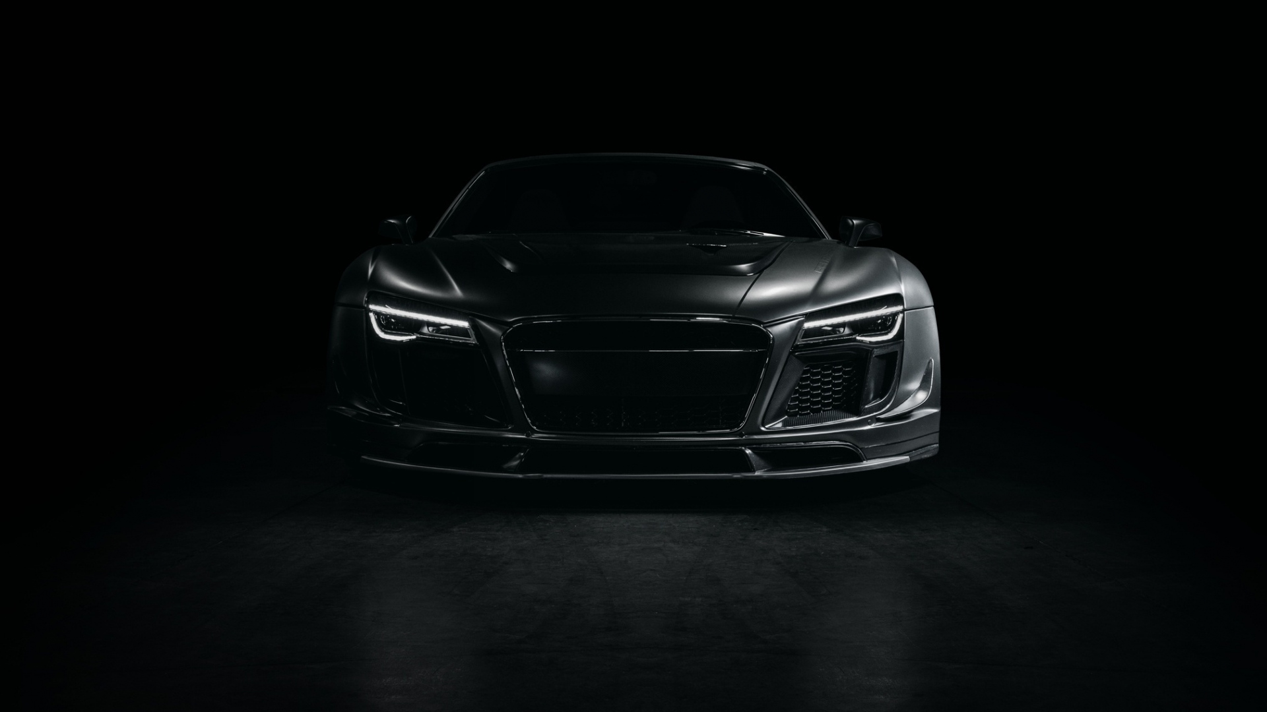
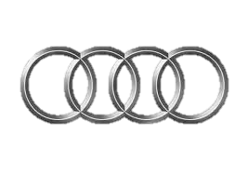


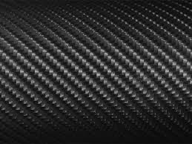




CAM Tuning & Performance
Home
Products
Events
Gallery
Home
Products
Sponsors
Gallery
News
Tax Return Sale 10% off Purchases Over $100 or More
Audi S5 B9 Stage 2 Now Available
VW GTI K04 Turbos!
Select Your Vehicle
Make
Series
Chassis
Engine
Drivetrain
Body Type
Auto racing began 5 minutes after the second car was built.
- Henry Ford -
Contact Us
About Us

Slide 2
CAM Tuning & Performance
Home
Products
Events
Gallery
News
Tax Return Sale 10% off Purchases Over $100 or More
Audi S5 B9 Stage 2 Now Available
VW GTI K04 Turbos!
Select Your Vehicle
Make
Series
Chassis
Engine
Drivetrain
Body Type
Auto racing began 5 minutes after the second car was built.
- Henry Ford -
Contact Us
About Us

Slide 3
Company Logo
Option 1
Option 2
Option 3
Option 4
Contact Us
About Us

Slide 4
Company Logo
Contact Us
About Us

